Slide 1
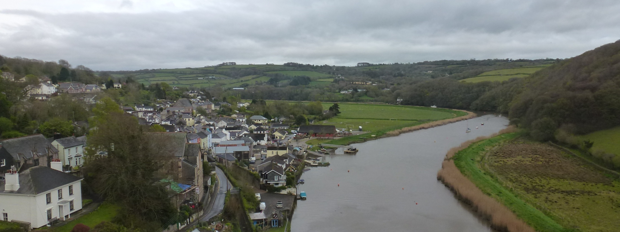
Spatial and temporal patterns in rainfall pollutant concentrations in the UK
Ron Smith, David Fowler, Christine Braban, Peter Levy, Lindsay Banin and Marcel van Oijen
NERC Centre for Ecology and Hydrology, Edinburgh, UK

Slide 2
Introduction
This talk will consider two aspects of data analysis on rainfall ion concentrations monitored over the UK for the past two decades
Trends in the data for sites
Spatial interpolation to create maps

Slide 3
Rural air quality monitoring
The UKEAP networks were brought together in 2009 to consolidate the rural background atmospheric composition measurements.
(http://pollutantdeposition.defra.gov.uk/ukeap)
As with many other national networks, the data are used for multiple different purposes.

Slide 4
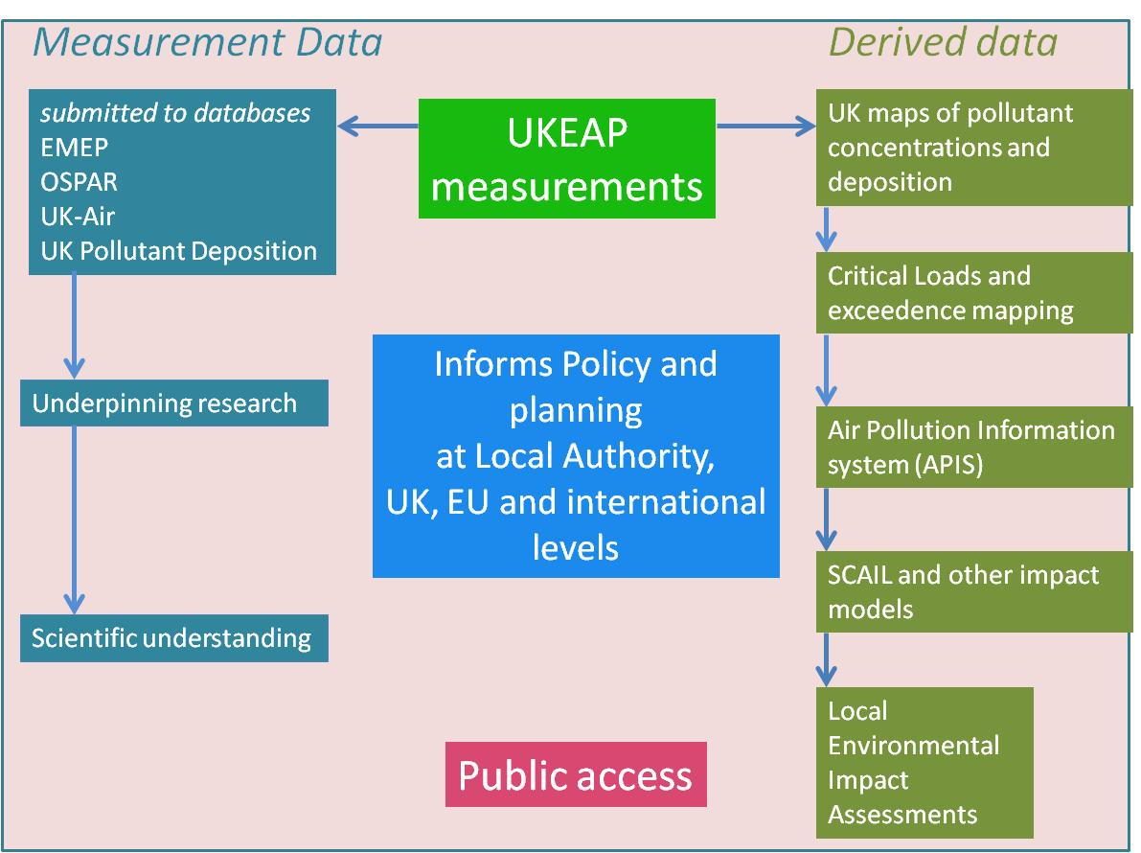
Links between UKEAP data and its uses

Slide 5
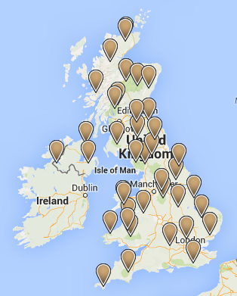
Rural air quality monitoring
Precip-Net, one of the UKEAP networks, had approximately 38 rural sites monitoring ion concentrations in rain from 2003 to 2014 (the network was setup in 1987 with 59 sites).
Concentration samples are currently collected every 2 weeks.

Slide 6
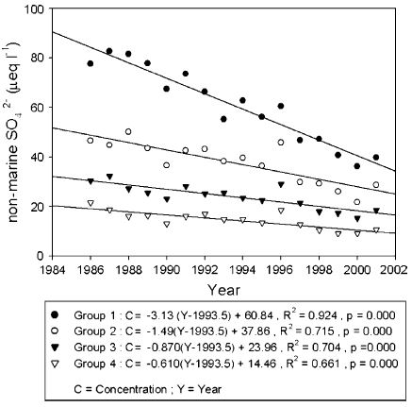
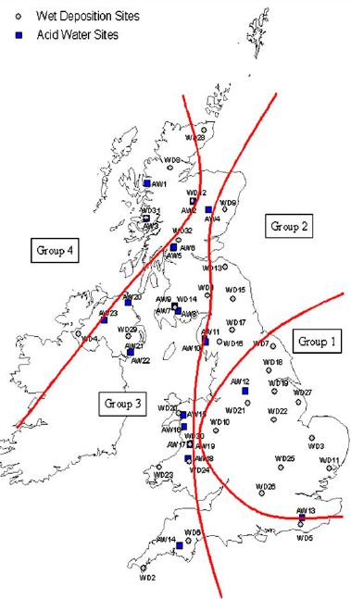
Trends over time
In previous work (Fowler et al, 2005) the monitoring sites were grouped to identify significant trends in different parts of the country.
D. Fowler , R.I. Smith, J.B.A. Muller, G. Hayman. K.J. Vincent (2005) Changes in the atmospheric deposition of acidifying compounds in the UK between 1986 and 2001. Environmental Pollution, 137, 15-25.

Slide 7
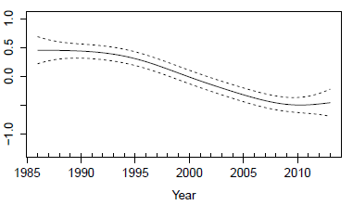
Non-linear time trends
There has been some criticism of this and other papers that the use of linear trends over time is too simple an approach.
Flexible smoothing techniques are one way of determining the pattern of rainfall ion concentrations over time without pre-defining any particular functional form.

Slide 8
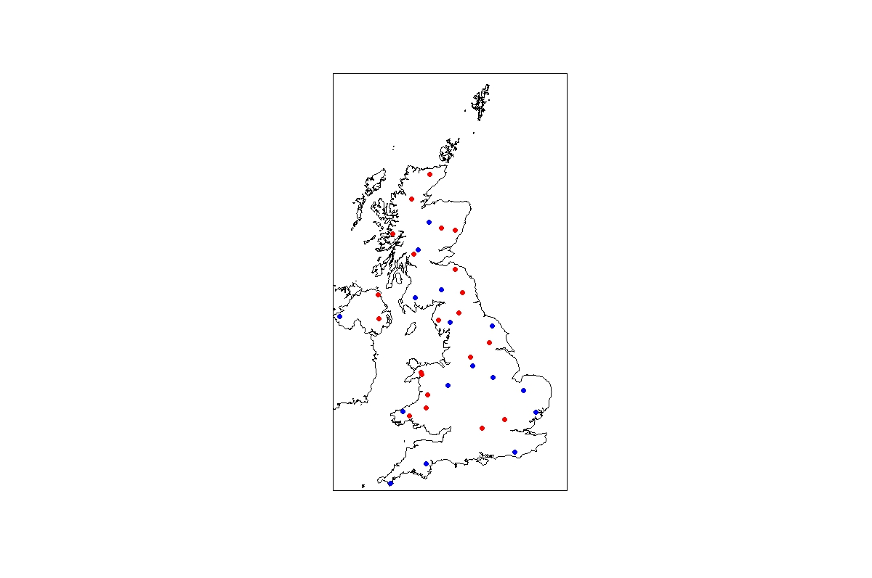
Site locations
Of the current 37 sites (2014) only 16 have data continuously from 1986.

Slide 9
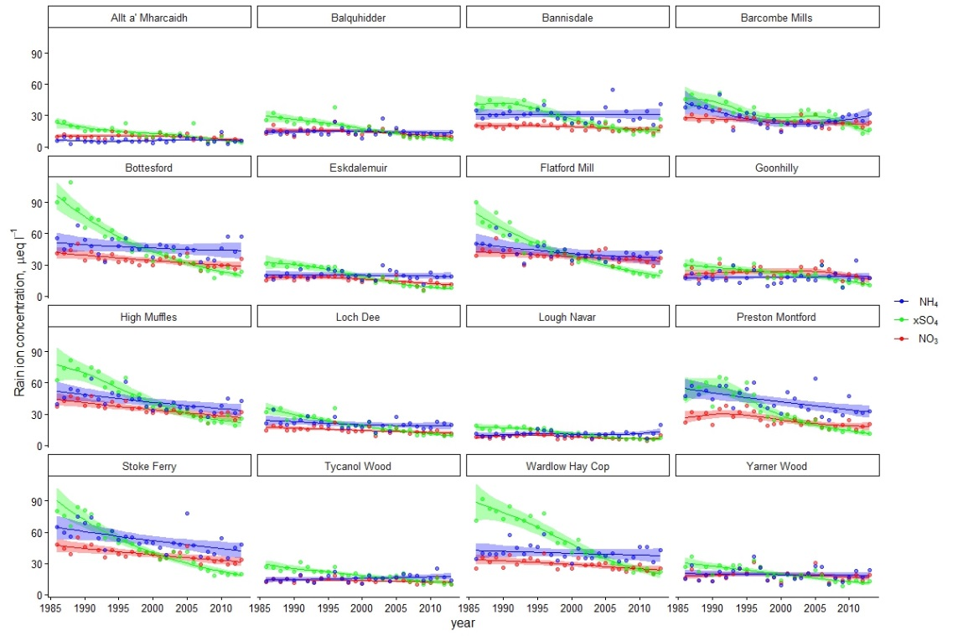
Non-linear time trends

Slide 10
Non-linear time trends

Slide 11
Summary of trend analysis
Inclusion of non-linear components of the trends was helpful for all three ions, as illustrated by the comparisons of decreases in concentrations derived from Table 1 being generally unequal over the two periods.
However, actually, the majority of trends could be fitted well by linear or approximately linear fits over this period, so the assumptions of linearity in previous analyses were not unreasonable.

Slide 12
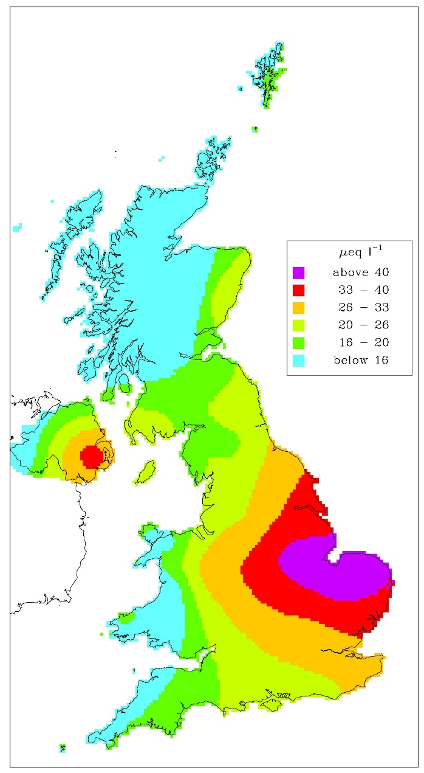
Rural air quality monitoring
The rainfall ion concentrations are also used to produce national maps of annual mean concentrations. Since 1986 this has been done by conventional kriging.
Annual mean concentration of ammonium in rainfall, 2012
This map is ‘fairly smooth’. Could fewer sites produce a similar result and what happens to the uncertainty?

Slide 13
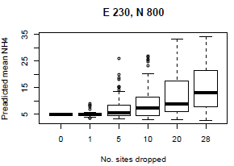
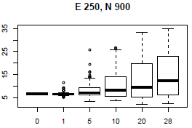
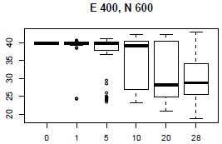
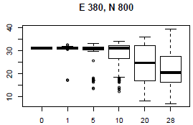
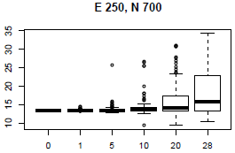
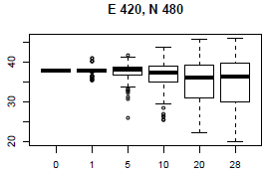
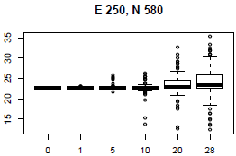
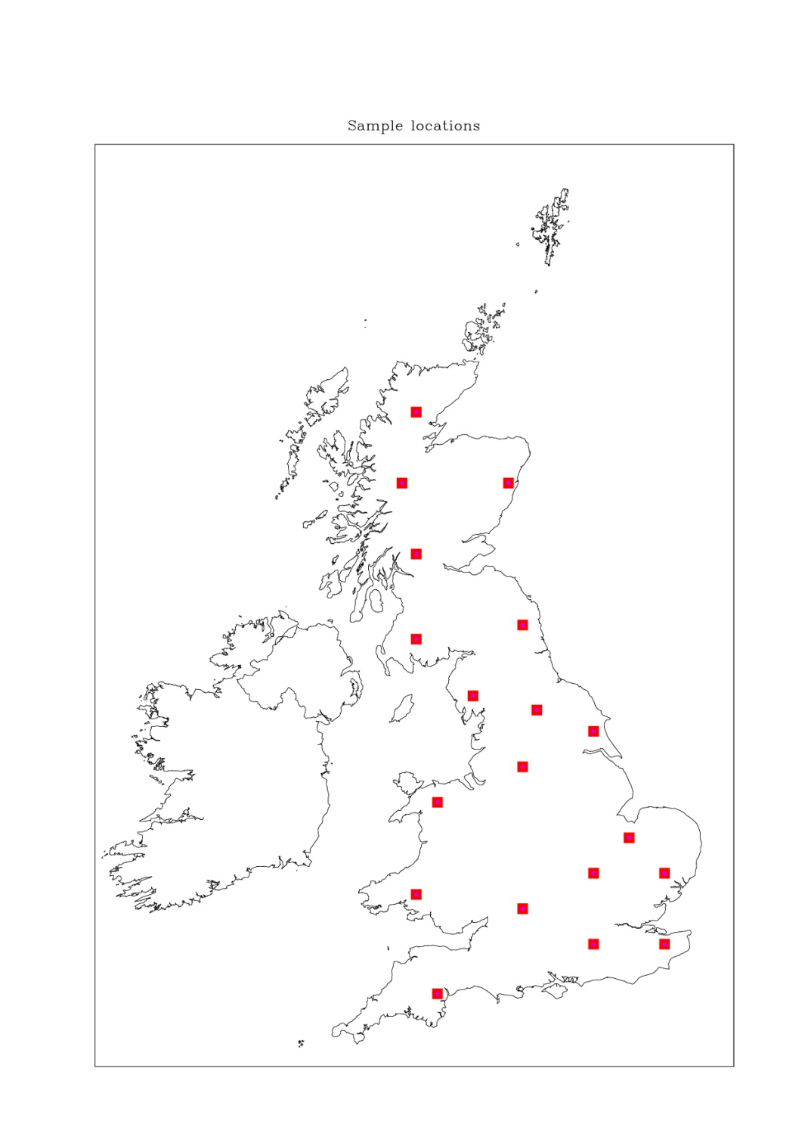
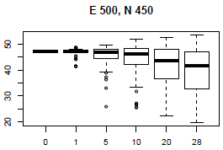
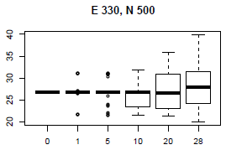
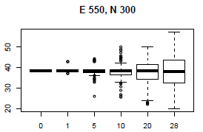
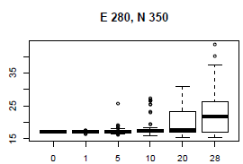
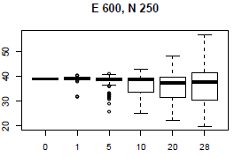
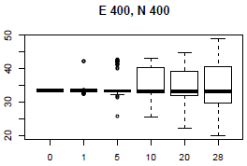
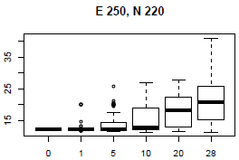
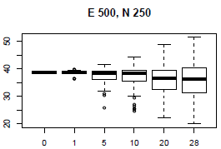
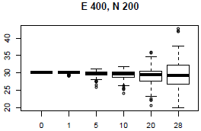
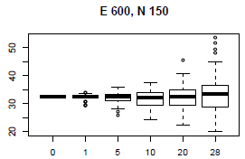
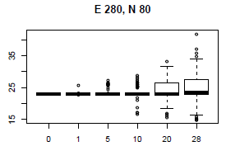
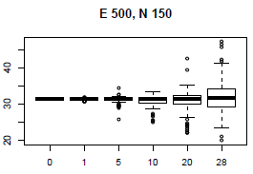
Random reductions in site numbers
The effect of random removal of sites from the network was studied using 100 simulations of each potential reduction.
19 locations were chosen to illustrate the output.
Boxplots of the 100 mapped values for each location are plotted against the number of sites dropped (from 1 to 28).

Slide 14
Study on random site reductions
As expected, the median uncertainty in the map increases as site numbers reduce.
However, also:
the median concentration of the100 simulations changes as more sites are dropped
the spread of the concentrations increases with fewer sites
The concentrations often increase in the west of the country and decrease in the east.
These latter effects become more pronounced when more than 10 sites are dropped.

Slide 15
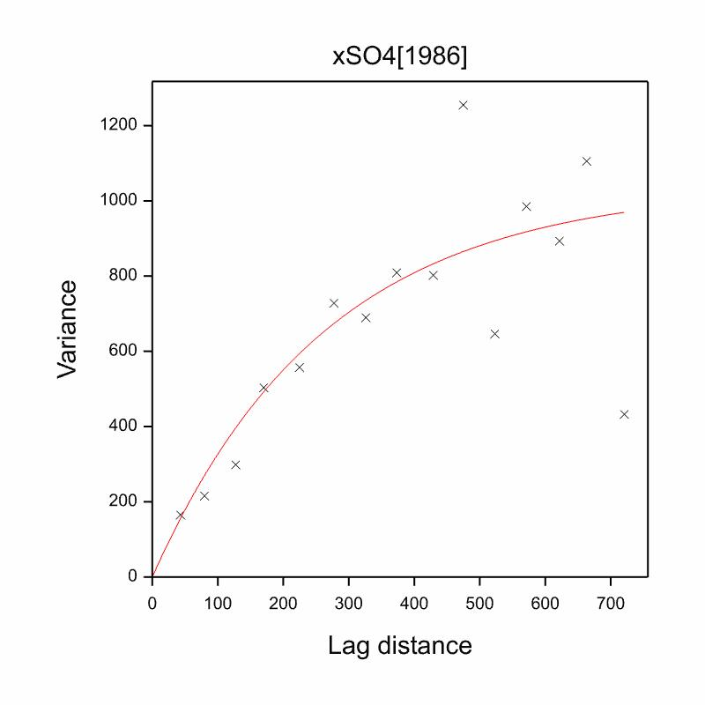
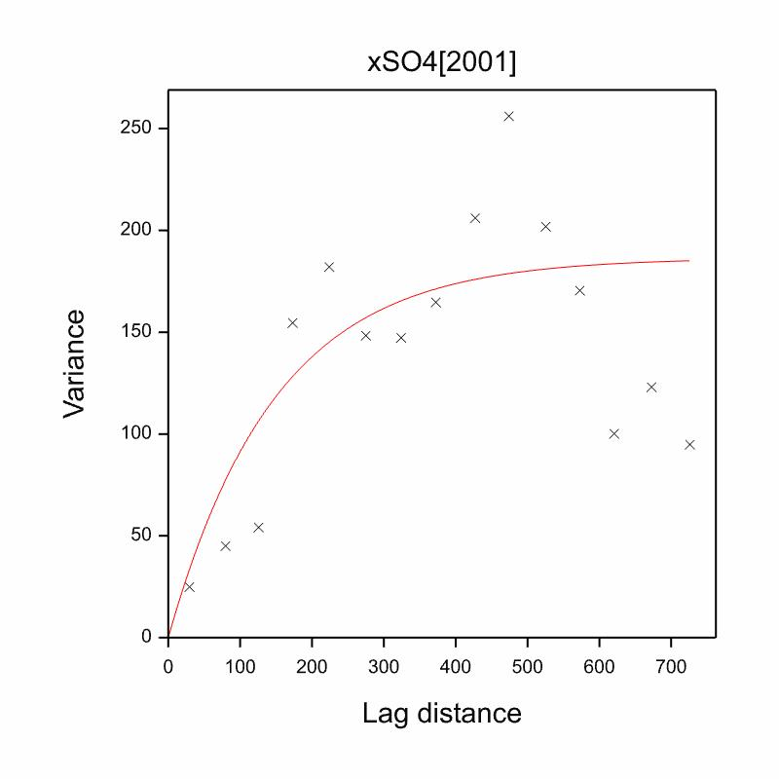
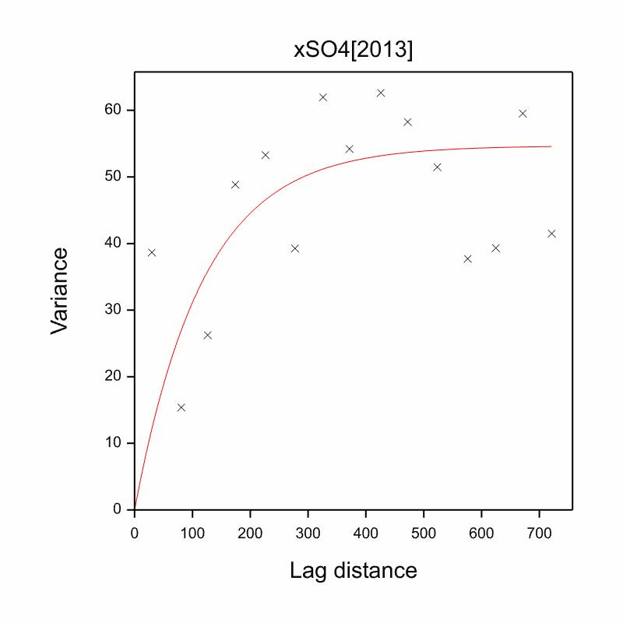
Conventional kriging – the variogram
Kriging is based on characterising the spatial variability using a variogram. It has become more difficult to defining the variogram over the smaller lag distances with previous reductions in site numbers over the years.

Slide 16
Conventional kriging – the maps (2013)

Slide 17
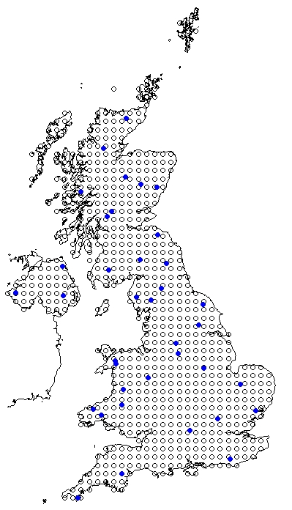
Prediction locations
For testing out Bayesian kriging, we choose a 20km grid of prediction locations - normally we map at 5km or 1km grids.
The current 37 sites are shown in blue.

Slide 18
Bayesian kriging
Bayesian kriging provides an improved and more complete estimate of mapping uncertainty

Slide 19
Bayesian kriging

Slide 20
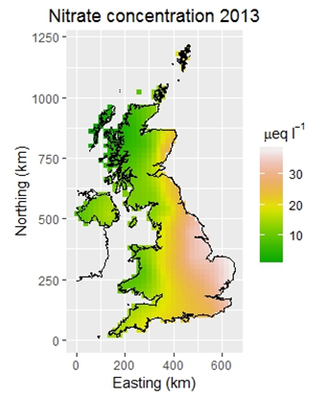
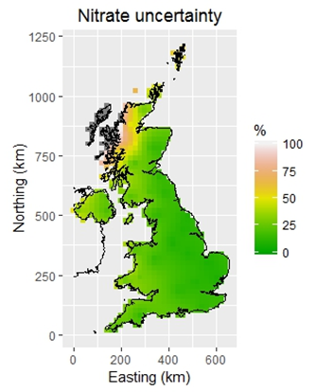
Bayesian kriging

Slide 21
A more general spatial-temporal model
A single spatial-temporal model could address both issues of trend summarisation and spatial mapping.
The R-package spT.timer was used to explore the usefulness of this approach using the non-seasalt sulphate data, a dataset that showed clear trends over time but with trends that varied over the mapped domain.
This package enables modelling of regularly monitored data from a sparse spatial network of monitoring stations, incorporating an arbitrary number of explanatory variables, which can vary in both space and time (Bakar and Sahu, 2015).

Slide 22
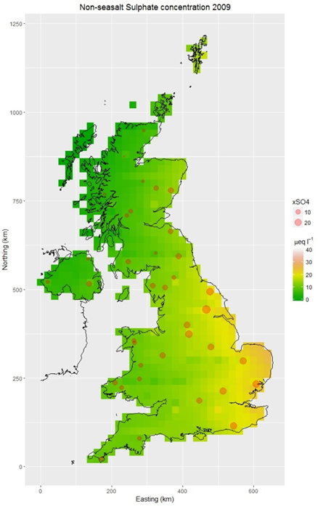
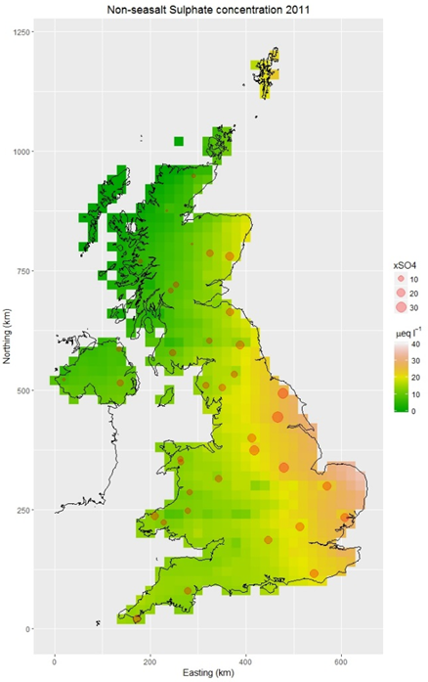
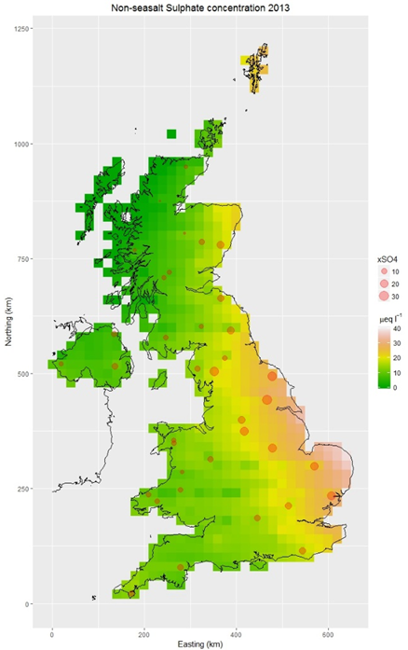
Mapping xSO₄ concentrations

Slide 23
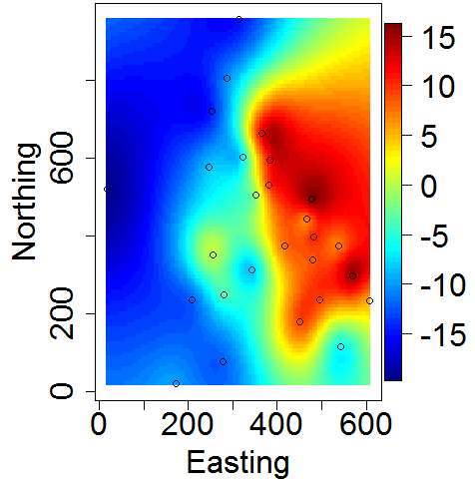
Another approach
Random effects plot from spBayes with covariate altitude (NO₃ 1986)

Slide 24
Conclusions
A Bayesian spatial-temporal model could provide an improved method of mapping concentrations and determining trends.
The current study shows a proof of concept and there are various issues still requiring to be addressed, for example handling missing data and checking the assumptions in the model specification.
The proof of concept and the simulation study show clearly that the choice of sites in the monitoring network affect both the mapped average concentration and the spatial pattern.

